Slide 1

Face Recognition using OpenCV
AYUSH KUMAR SINGH
4TH SEMESTER
GRAPHIC ERA DEEMED TO BE UNIVERSITY
SUPERVISOR- MR. RISHI KUMAR

Slide 2
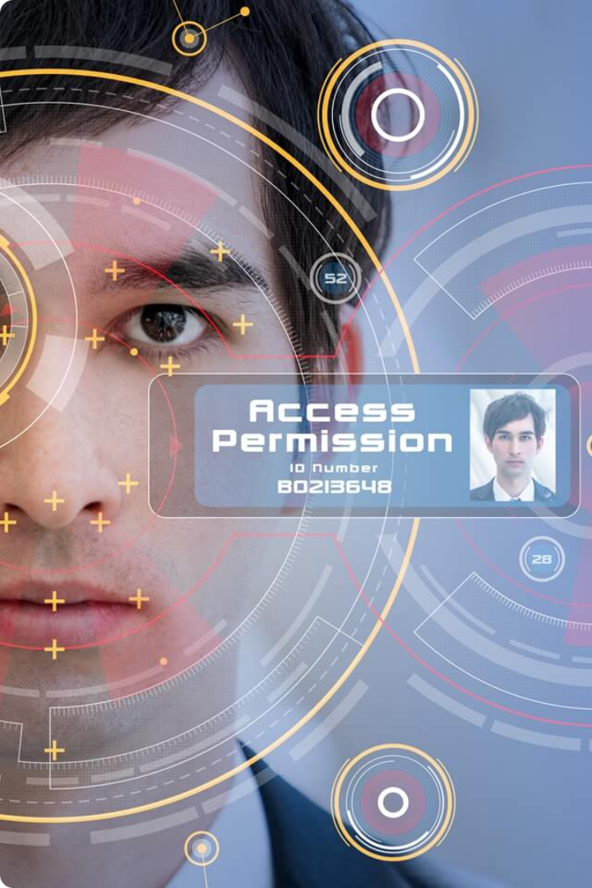

Face Recognition using OpenCV
Face recognition technology has become a critical component in numerous modern applications, ranging from security systems and surveillance to identity verification and human-computer interaction. This project aims to provide a comprehensive overview of building a face recognition system using OpenCV, detailing the process from training the face recognizer to implementing real-time face detection and recognition.

Slide 3


The Power of OpenCV
1
Comprehensive Tools
OpenCV, initially released in 2000, has become one of the most widely used libraries for computer vision applications. It provides a comprehensive set of tools for image and video processing, making it an ideal choice for implementing face recognition systems.
2
Diverse Algorithms
OpenCV supports various face detection and recognition algorithms, including Haar Cascades, Local Binary Patterns Histograms (LBPH), and deep learning-based methods, allowing for flexibility in developing robust and efficient face recognition solutions.
3
Cross-Platform Compatibility
The cross-platform nature of OpenCV enables the deployment of face recognition systems on a wide range of devices, from desktop computers to embedded systems, making it a versatile choice for diverse applications.

Slide 4

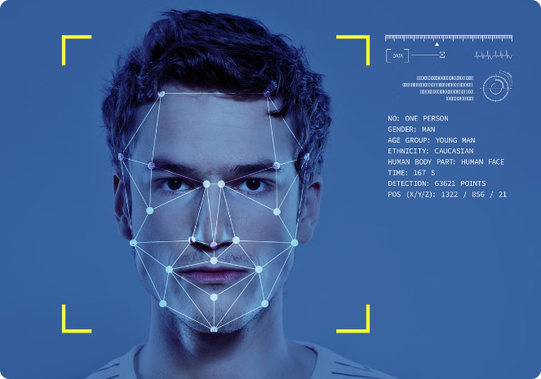
Training the Face Recognizer
1
Data Preparation
The training process begins with preparing a dataset of face images, converting them to grayscale, and detecting faces within the images using Haar Cascade Classifiers. This step is crucial for extracting the relevant facial features for the recognition model.
2
LBPH Recognizer
The project utilizes the Local Binary Patterns Histograms (LBPH) algorithm to train the face recognizer. LBPH is a texture-based face recognition method that extracts local binary patterns from the face images and uses histograms of these patterns to represent and recognize faces.
3
Model Training
The extracted face regions and corresponding labels are used to train the LBPH recognizer. The trained model is then saved, along with the label mappings, to be used in the real-time face recognition phase.

Slide 5






Real-time Face Recognition
Video Capture
The real-time face recognition script captures video from a webcam, converting each frame to grayscale for efficient processing.
Face Detection
Haar Cascade Classifiers are used to detect faces within the video frames, locating the bounding boxes around the detected faces.
Feature Extraction
The detected face regions are then passed through the LBPH feature extractor to create a compact representation of the facial features.
Face Recognition
The extracted features are compared against the trained model to recognize the individuals in the video stream, displaying their names in real-time.

Slide 6
Challenges and Limitations
Lighting Conditions
Facial Expressions
Partial Occlusions
The system's accuracy can be affected by varying lighting conditions, making it challenging to recognize faces in low light or with strong shadows.
Changes in facial expressions can affect the system's ability to recognize faces accurately, as the LBPH algorithm is sensitive to these variations.
The presence of occlusions, such as hats, glasses, or masks, can hinder the system's performance, as they can obscure key facial features required for recognition.

Slide 7

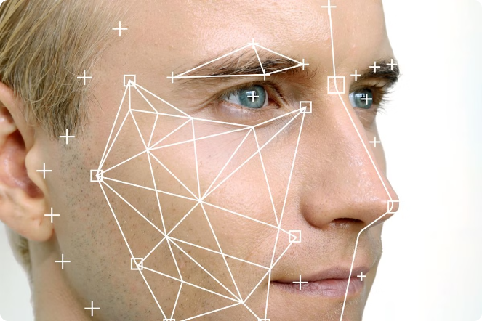
Enhancing the System
Advanced Techniques
Integrating deep learning-based methods can significantly improve the system's accuracy and robustness, particularly in handling challenging scenarios like varying lighting conditions and partial occlusions.
Dataset Quality
Improving the quality and diversity of the training dataset, including images with diverse lighting, expressions, and poses, can enhance the system's ability to recognize faces in real-world scenarios.
Real-time Performance
Optimizing the system's computational efficiency and implementing techniques like GPU acceleration can improve the real-time performance, making the face recognition system more suitable for deployment in live applications.
Expanded Functionality
Incorporating additional features like emotion recognition, age estimation, and gender classification can expand the system's capabilities and make it more versatile for a wider range of applications.

Slide 8

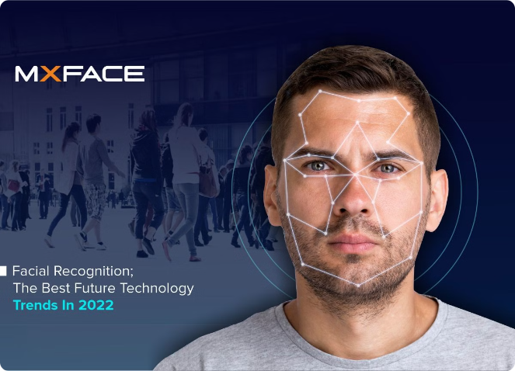
Conclusion
Comprehensive Solution
The face recognition system developed in this project provides a solid foundation for recognizing faces in real-time, leveraging the power of OpenCV and its diverse computer vision algorithms.
Opportunities for Growth
By incorporating advanced techniques, enhancing dataset quality, improving real-time performance, and addressing security and privacy concerns, the system can be further refined and expanded to meet the evolving needs of various applications.
Towards a Safer, Smarter Future
The advancements in face recognition technology, as demonstrated in this project, contribute to creating a digital environment that is safer and more personalized for public use, with numerous potential applications in security, identity verification, and human-computer interaction.

